Slide 1

Research strategy
Dr Alveen Singh
Department of Information Technology
Research Skills/Project 3A
Adv Dip ICT/B.ICT
Semester 1 2023

Slide 2
Content
Introduction
Case study
Survey
Design Research
Experiment

Slide 3
Introduction
The research strategy outlines the plan for the research.
The strategy will guide the creation of objectives, data collection and data analysis.

Slide 4
The choice of strategy is linked to the aim of the research.
For example, should the research aim to develop a new or improved AI algorithm, then Design research would be a more suitable choice than Survey.
If the research aims to understand the practices of a unique software engineering team then a Case Study would be more appropriate than an Experiment. A survey is useful for measuring the attitude of an entire population.

Slide 5
For this module we will focus on four popular types in research.
  Survey
  Case study
  Experiment
  Design research

Slide 6



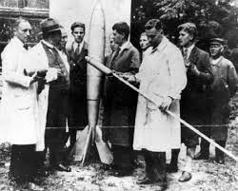
Case Study
To understand something that is unique
  It could be a strange phenomena
    Rural village that produces top computer scientists
  Unique business processes or practices
  Or an individual or team

Slide 7
This single case is studied in-depth to obtain a rich, detailed insight.
Data collection techniques can include researcher’s field notes, interviews, observation, document analysis and questionnaires.
The case is examined in its natural setting.
  A simulated environment may not result in accurate data collection
The researcher tries to understand interfaces, connections and linkages that lead to the complex relationships and processes.
There are multiple sources of data and methods for collection to obtain multiple perspectives.

Slide 8
Types of case study
Exploratory
  Results in questions or hypothesis for a later, larger study. It helps the researcher to identify a problem or confirm a “hunch”.
Descriptive
  is an in-depth investigation and a detailed analysis of a particular case.
Explanatory
  one step further than descriptive study. It attempts to explain why and how events happen.

Slide 9
Which are examples of Case Study research?
A investigation of Information Management Security Policy in Law Firms in Durban South Africa
A review of Machine Learning techniques used for maize crop detection
Application of Malaria detection Information Systems in Niassa Province in Mozambique
Developing a cloud based eHealth document tracking system
Towards improved understanding of program management practices in Scrum: a comparison of two RSA software development SMEs

Slide 10

Survey
Survey allows the researcher to identify patterns and trends of a population
These patterns and trends tell us something about the population
  E.g. what are the most problematic features of a VLE?
  What are the most frequently utilized tools in a developer platform?
Getthematic.com

Slide 11

Surveys are conducted using online tools
Online survey tools are useful because:
  Templates: a library of pre-designed questionnaire templates which can be matched to the type of survey
  Survey logic: navigates the participant through the survey avoiding unnecessary questions
  Flexible design: lets the researcher change colours, fonts, images and language
  Data analysis: performs analysis of the collected responses and presents the results in a visual format
  Multi-language: provides support for switching the language of the questions instead of having to retype them

Slide 12
Basic steps
Researchers design questionnaires based on the findings of literature review
  E.g.
    1: Literature review identifies a set of useful features for University administration assist chatbots
    2: Design a set of questions based on the literature review. Develop the survey.
    3: Participants complete the survey and the software analyses the results.
    4: The results confirms/does not confirm features. Also, identifies new information.

Slide 13
A survey is intended to collect data from a large sample of participants.
  More than 80
The findings of the study from the sample is then used to generalize across a larger population.
In other words, this information or opinion collected from the sample is more often a generalization of what a large population thinks.
Inference

Slide 14
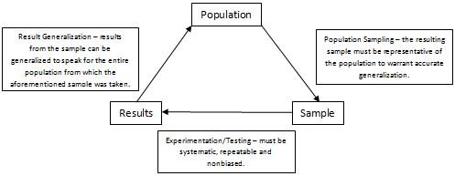
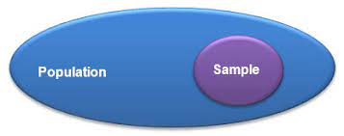
Explorable.com

Slide 15
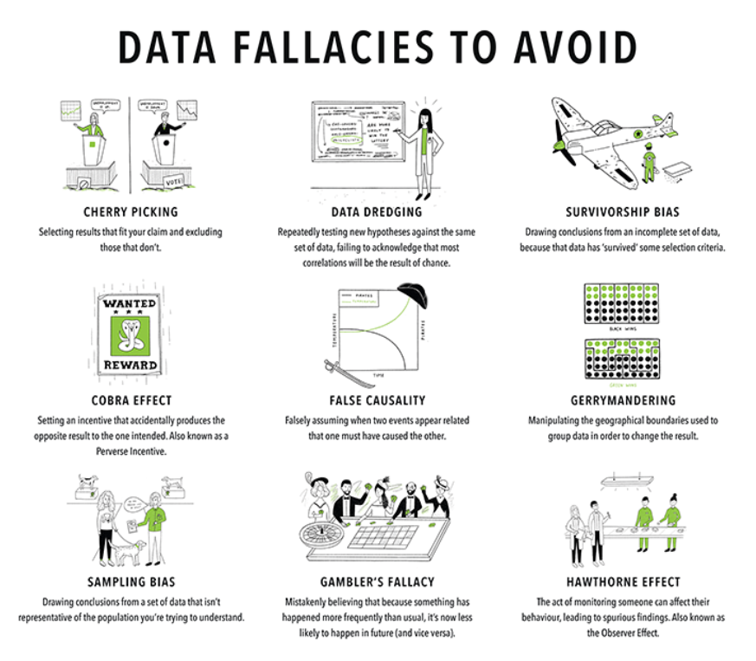
Collected data must
not be manipulated!
Datasciencecentral.com

Slide 16
How are surveys conducted?
There are two main ways of deploying surveys, longitudinal and cross-sectional.
A cross-sectional survey is used to collect data relevant to that period in time. It allows for the researcher to determine the state of affairs in that moment in time. These surveys are short and focus on one aspect of research.
Longitudinal survey involves the collection of data over a long period of time
(5 years to 5 decades).

Slide 17
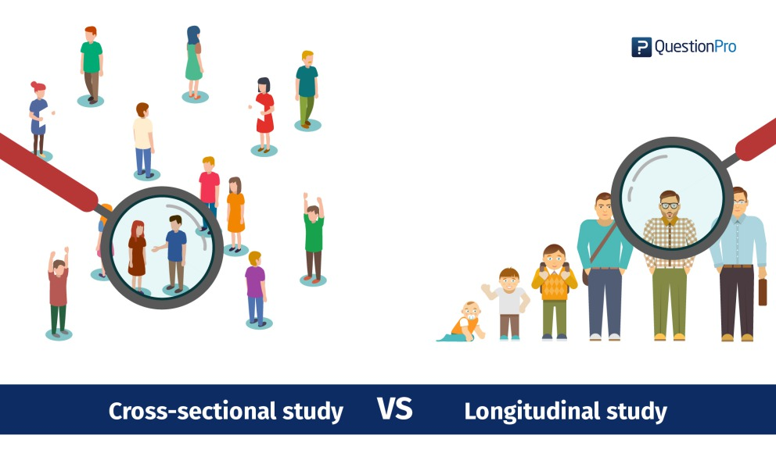
QuestionPro.com

Slide 18






Which is longitudinal? Which is cross sectional?

Slide 19
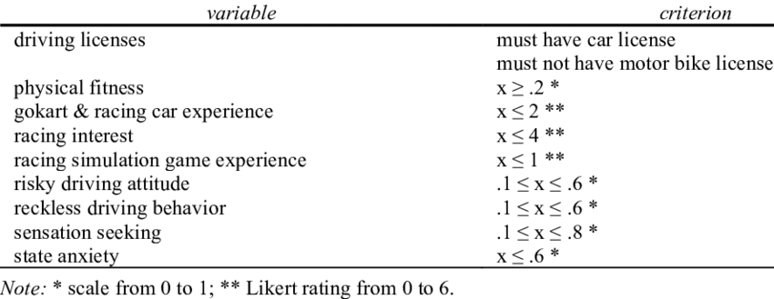
There are three main types of longitudinal survey trend, panel and cohort.
  A cohort survey is when the participants are selected for the sample using certain selection criteria.
    E.g selecting students that entered the first year from school quintiles 1 to 3.
ResearchGate

Slide 20
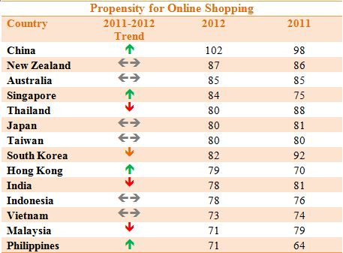
  Trend surveys are used to show how participants opinions change over time.
    E.g. what was the first year IT student’s opinion of online classes in their first year of study compared to now in their fourth year.
    E.g. Online shopping trends across regions
Teh, 2021

Slide 21
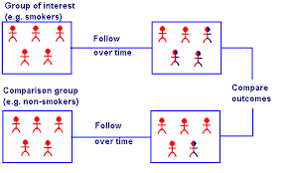
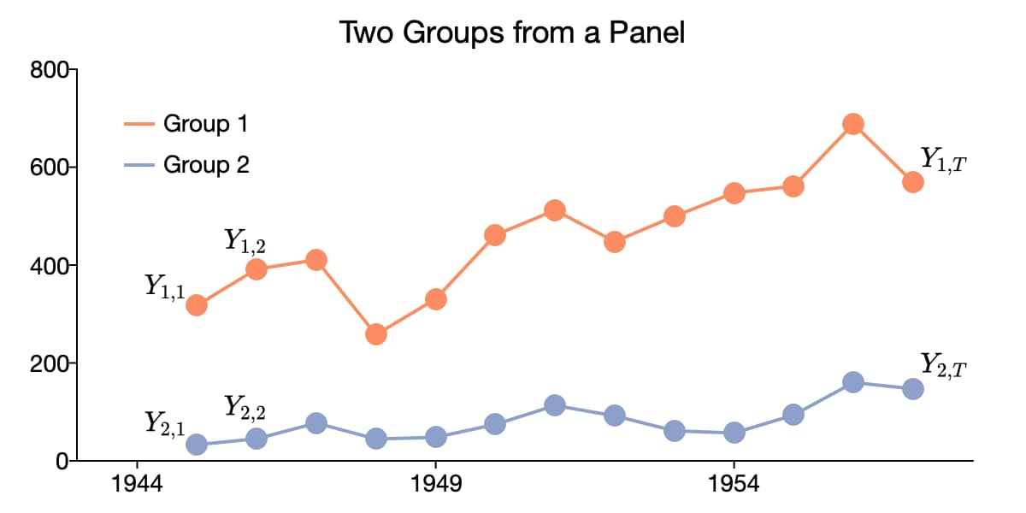
  Panel survey when data is collected from the same sample over time.
    E.g the same sample of students from first year to fourth year. This allows for a more accurate telling of the change over time as the same participants are used.
Aptech, 2021

Slide 22
Some advantages of using surveys
  Online surveys are quick to develop and administer.
  The analysis of collected data is faster due to built in statistical tools.
  A wide reach is achievable.
  Participation can be controlled.
Some disadvantages of using surveys
  The type of responses can be limited by the design or template used in the questionnaire.
  The design of the questionnaire has to be correct otherwise the incorrect data will be collected.
  Certain data can be missed out if there are no questions aimed at collecting that data.

Slide 23
When would you use a Survey?
Four friends need to decide on what beer to buy
KFC wants to update menu selection
Find the best ML technique to identify features in VLE implementation
Census 2050
To determine reasons for channel zapping
To test a new IoT-based marine salvage system

Slide 24



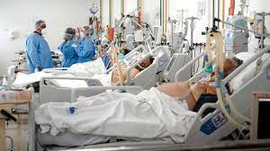
Design Research
To solve persistent societal and industry problems
Leverage different areas and developments in ICT to
propose viable, practical solutions
Developments in ML, DL, CV, CS, IoT etc.

Slide 25


Design science research has two main activities:
  The creation of a new knowledge via an innovstive technological artefact
  Evaluate the performance of the new artefact for effectiveness
Sonda.com
Shutterstock.com

Slide 26
In design research the development and evaluation of a technological or knowledge artefact is a key contribution

Slide 27
Which are examples that arise from Design Research?
user interface heuristics
meta analysis
algorithms for search engines and cybersecurity
an understanding of Google software dev practices
Scrum
DL or ML models
Opinion of UX designers
ChatGPT

Slide 28
Vaishnavi (2019

Slide 29
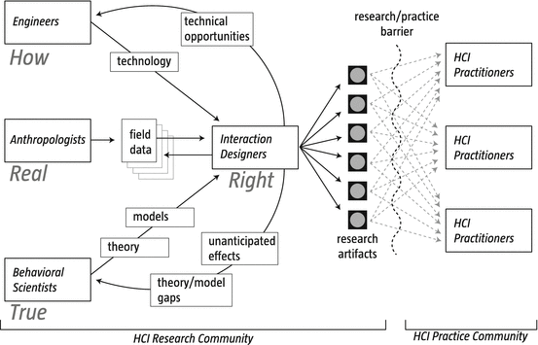
An example design research from the field of HCI
Zimmerman, 2014

Slide 30
Examples of Design Research
Developing a mobile learning framework for the ICT4RED project in Eastern Cape Province of RSA
https://researchspace.csir.co.za/dspace/handle/10204/7927
See: https://worldwidescience.org/topicpages/d/design+science+research.html

Slide 31
Experiments
Experiments are set up to understand the relationships between two or more variables
The contribution of this research is an understanding of how one variable effects the other/s

Slide 32
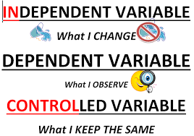
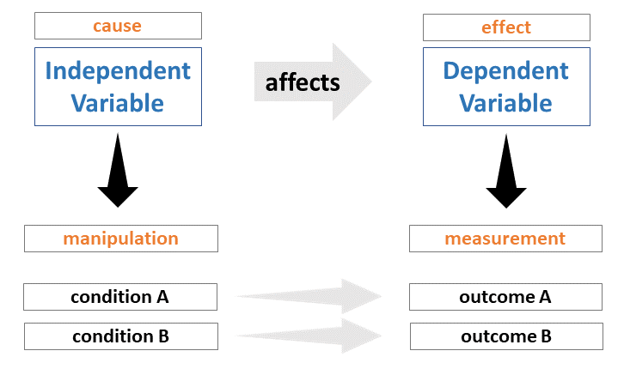
tobbipro
Kennedy.sb.school

Slide 33
The independent variable effects one or more dependent variables
A dependent variable changes as a result of changes to the independent variable
The experiment manipulates the independent variable (to observe changes in the dependent variable)
It is good practice to have at most, two independent variables
tobbipro

Slide 34











Which is dependent var? which is independent var?

Slide 35
Controlling variables
Experimental research depends on the researcher’s ability to isolate factors and show that only one factor causes an observed change.
Approaches for controlling variables include:
Eliminate outlying factors –
  for example, the experiment requires experienced Scrum developers, so those developers not practiced with Scrum will be removed.
Control groups –
  two groups are set up with exactly the same characteristics for example, developers with the same expertise and years of experience. For one group, the control group there is no manipulation of the of the independent variable. For the second group, the experimental group, independent variable is manipulated. Effects are measured in each group. Any noted differences in the outcome is a result of the variable that was manipulated.
Random selection –
  when there are enough participants chosen on a random basis and those participants that interfere with the outcomes cancel each other out across the selection (for example, not enough Scrum experience)

Slide 36
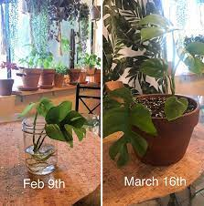
Measurement
Measurements need to be performed before and after the experiment.
This is referred to as pre- and post- testing.
E.g. hypothesis:
  Implementation of anti-X will result in improved team communication
The effect of anti-X can’t be effectively measured with just a post-test measurement.
Instead, there must have been some pre-test measurement, to establish a benchmark and to measure any change.
Measurement usually includes quantitative data and statistical analysis.

Slide 37
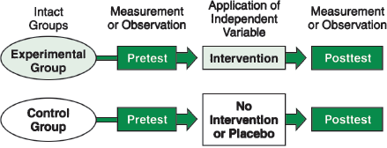
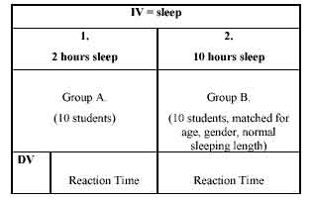
Portney and Watkins,
McLeod, 2017

Slide 38
3 types of experiments
True
Pre-
Quasi

Slide 39
True experiments contain three key features: independent and dependent variables, pretesting and post-testing, and experimental and control groups.
In a true experiment, the effect of an intervention is tested by comparing two groups.
One group is exposed to the intervention (the experimental group, also known as the treatment group) and the other is not exposed to the intervention (the control group)
(Pressbook, 2021)

Slide 40
Pre-experiments are called such because they happen before a true experiment is conducted.
Researchers want to see if their interventions will have an effect on a small group of people before they seek funding and dedicate time to conducting a true experiment
(Pressbook, 2021)
Pilot testing

Slide 41
nonrandomized, pre-post test intervention studies
A Quasi-experiment does not rely on random assignment. Instead, participants are assigned to groups based on careful selection criteria.
e.g. A student is introducing a pharmacy order-entry system aimed at municipal hospitals. The intervention is implemented and pharmacy operating costs are measured before and after the intervention.

Slide 42
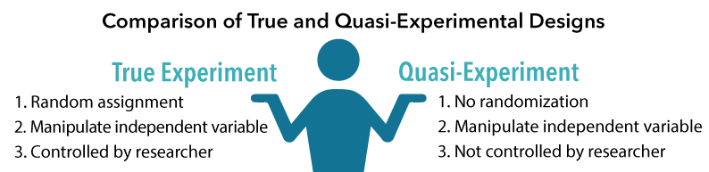
Freberg, L. et al. (2017)

Slide 43
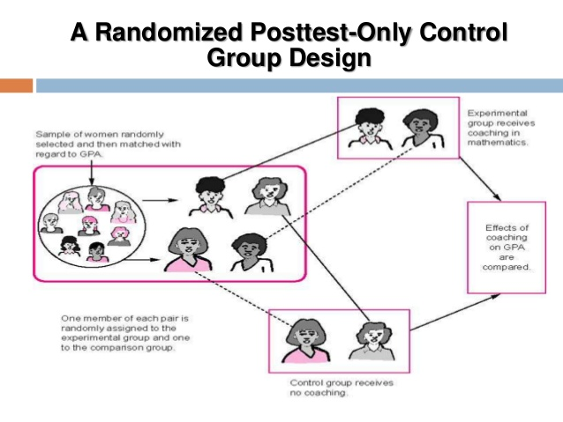
Prabakar, 2014

Slide 44
Hypothesis testing
A hypothesis is a proposed explanation for a phenomenon. It can be viewed as a prediction of what might happen.
The hypothesis is a statement that is in the form:
Factor A causes B
This hypothesis is formulated such that it can be tested empirically via an experiment.
  It must also be formulated such that it is falsifiable that is, it can be true or false.
The aim of hypothesis testing to try to disprove just as vigorously as approve.

Slide 45
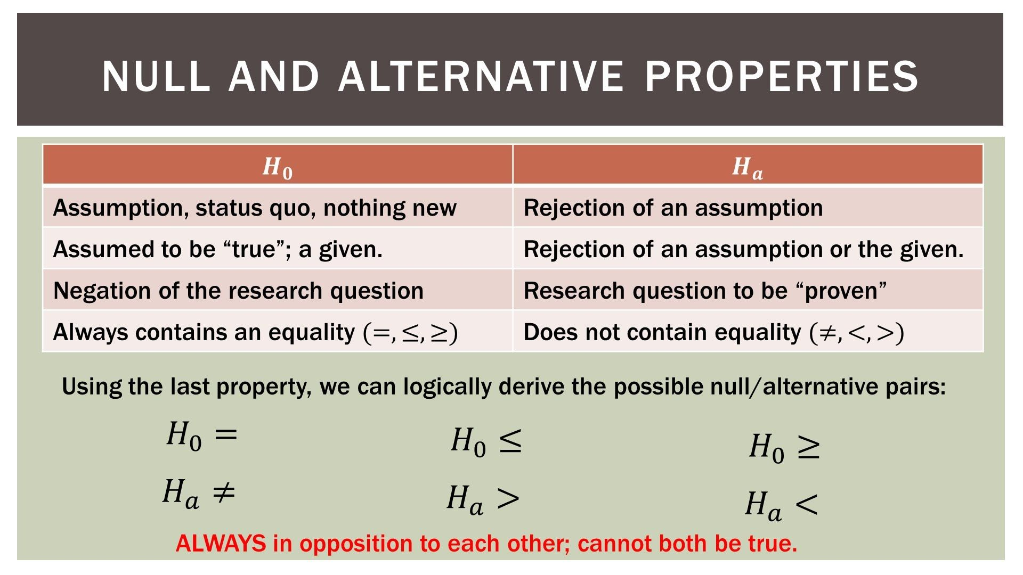
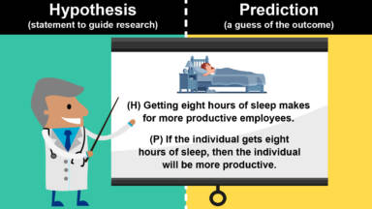
Foltz, 2016
Betts, 2021

Slide 46
Which are the correctly formulated hypothesis?
    H₂O will freeze when the temperature drops below 1 degree Celsius
    Research is better than programming
    Which is the better deep learning model for credit card fraud detection?
    Random forest classifier allows faster error prediction in mobile dev projects than neural networks
    IoT system developed for mine safety
    Scrum project management will not result in more user centric software designs

Slide 47
Please read the lecture note for this section.
Available on Moodle.
Questions and comments are welcome: alveens@dut.ac.za

